Slide 1
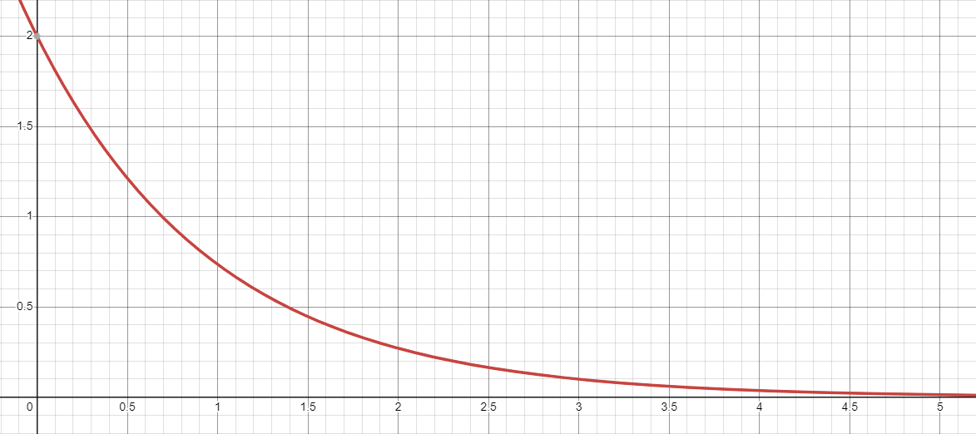
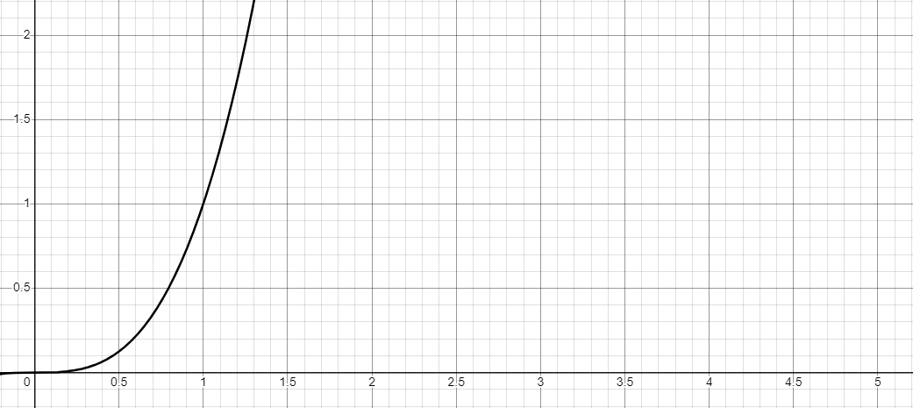
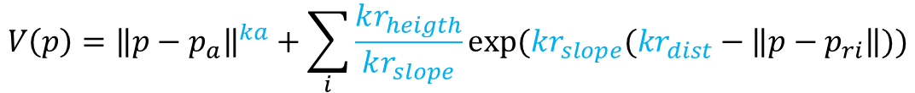
Vector field controller: Formulas implemented are the following
V(p) is a 2D potential created so that repulsive points ($p_{ri}$) are hills and the attractive point ($p_{a}$) is a hole.
The robot follows $−grad\left(V\right)$ to converge to the attractive point.
$$V\left(p\right)={\left\|p−p_{a}\right\|}^{ka}+\sum_{i}{\frac{kr_{heigth}}{kr_{slope}}exp⁡(kr_{slope}(kr_{dist}−\left\|p−p_{ri}\right\|))}$$
$$−grad\left(V\right)=−ka\left(p−p_{a}\right){\left\|p−p_{a}\right\|}^{ka−1}+\sum_{i}{\frac{p−p_{ri}}{\left\|p−p_{ri}\right\|}kr_{heigth}exp⁡(kr_{slope}(kr_{dist}−\left\|p−p_{ri}\right\|))}$$
Repulsive potential shape, customizable with: $kr_{dist}, kr_{heigth}, kr_{slope}$
Attractive potential shape, customizable with: $ka$
Max repulsive value
Effect radius
Attractivity is really high for far points
$$x=\left\|p−p_{r}\right\|$$
$f\left(x\right)=2 ∙exp⁡(1∙(0−x))$
$$x=\left\|p−p_{r}\right\|$$
$$f\left(x\right)=x^{3}$$
We need to clamp those functions to avoid unwanted very high gradient values

Slide 2
Speeds Clamping strategy
Parameters
Ka: Attractivity force
Kr_dist: Repulsivity offset radius
Kr_height: Repulsivity force
Kr_slope: Repulsivity cliff slope
Min_spd_norm: Minimal speed norm
Max_spd_norm: Maximal speed norm
Compute repulsive field only
Kr_dist, Kr_height, Kr_slope
Compute attractive field only
Ka
Clamp: [0.0 , Max_spd_norm]
Clamp: [Min_spd_norm , Max_spd_norm]
Merge clamped fields
Clamp: [0.0 , Max_spd_norm]
Send to robot

Slide 3
Vector field controller Implementation
Compute attractive field
If command received:
Apply constant speed command on all field
Else:
Compute point following
Received Point
Attractive point
(PointStamped)
Attractive field
Received command
Teleoperation
(Twist)
Clamping and merging
Final field
scan
Repulsive obstacles
(LaserScan)
Compute repulsive field
Repulsive field
The package directly manage point following and speed commands (teleoperation) features

Slide 4
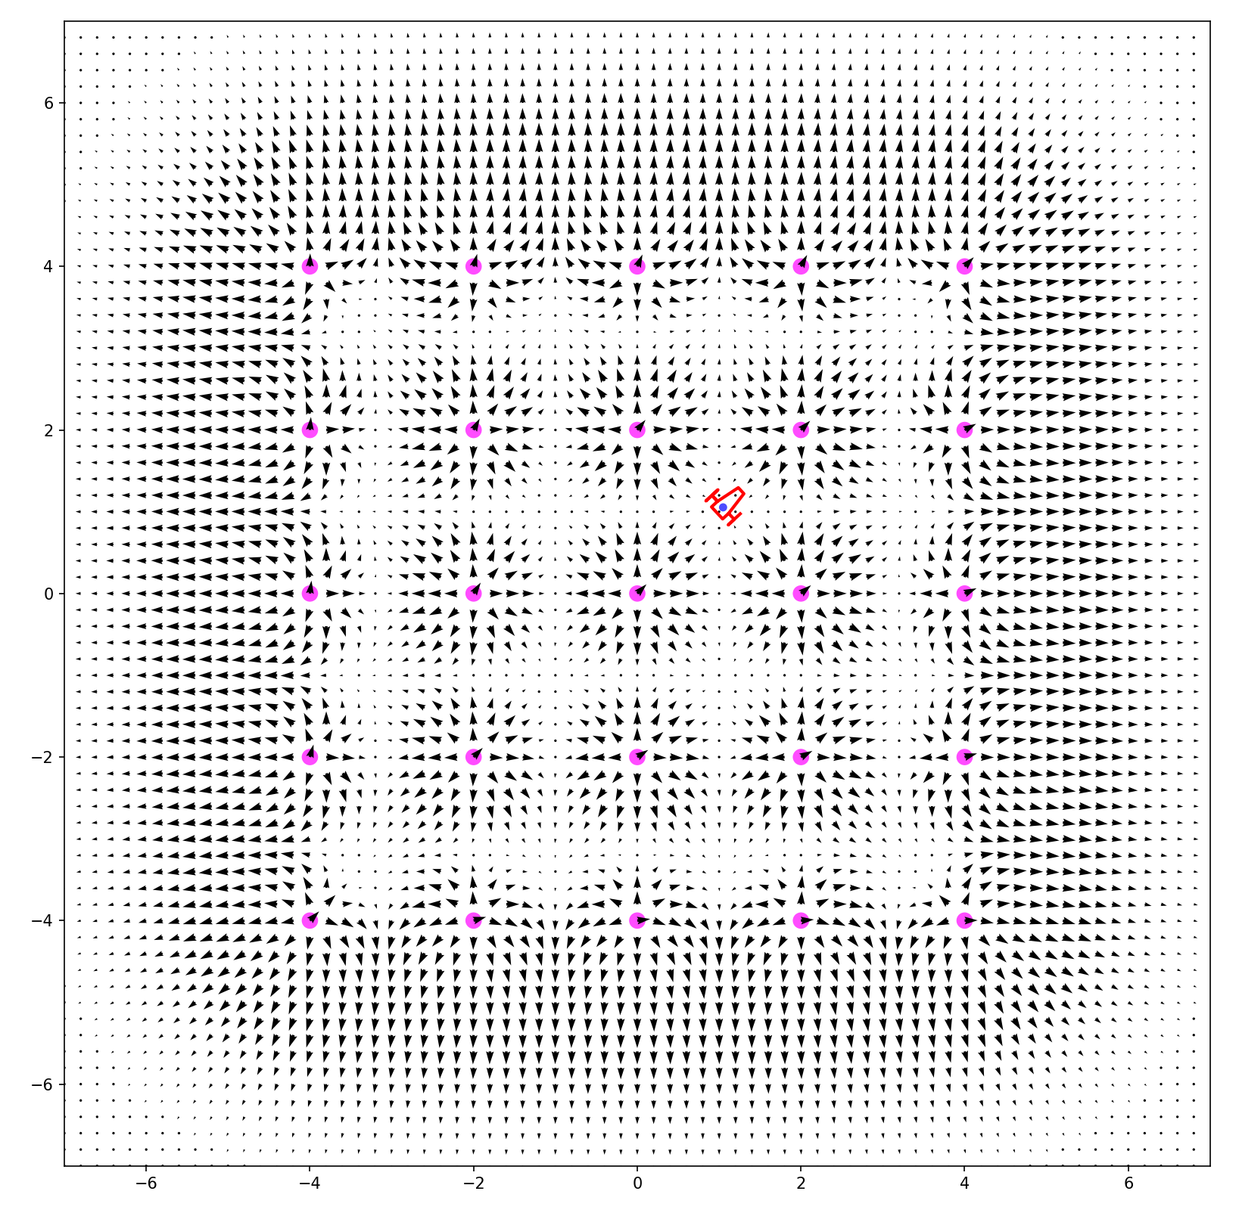
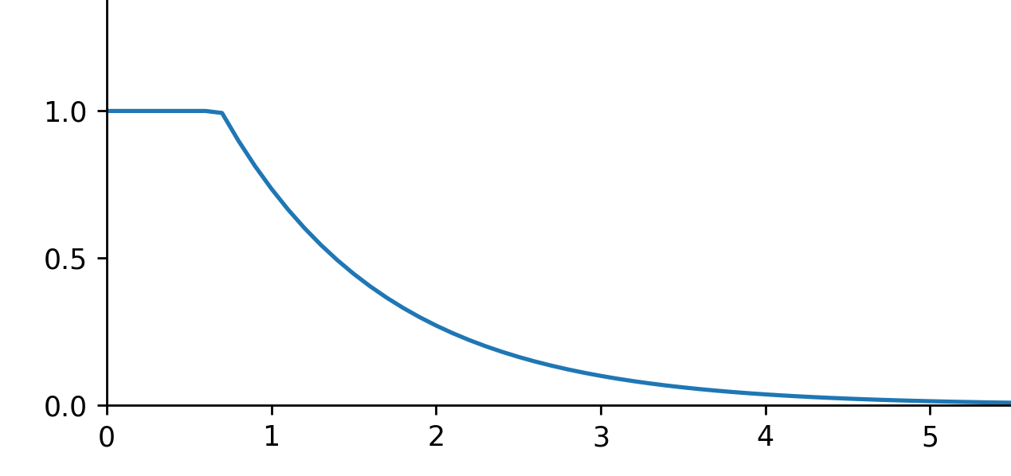
Visualization (Python program): Repulsive only
Unclamped Repulsive potential
$f\left(x\right)=2 ∙exp⁡(1∙(0−x))$
Max possible repulsive value
Effect radius
Clamped Repulsive potential
$$x=\left\|p−p_{r}\right\|$$
Ka: 0.0
Kr_dist: 0.0
Kr_height: 2.0
Kr_slope: 1.0
Min_spd_norm: 0.1
Max_spd_norm: 1.0

Slide 5
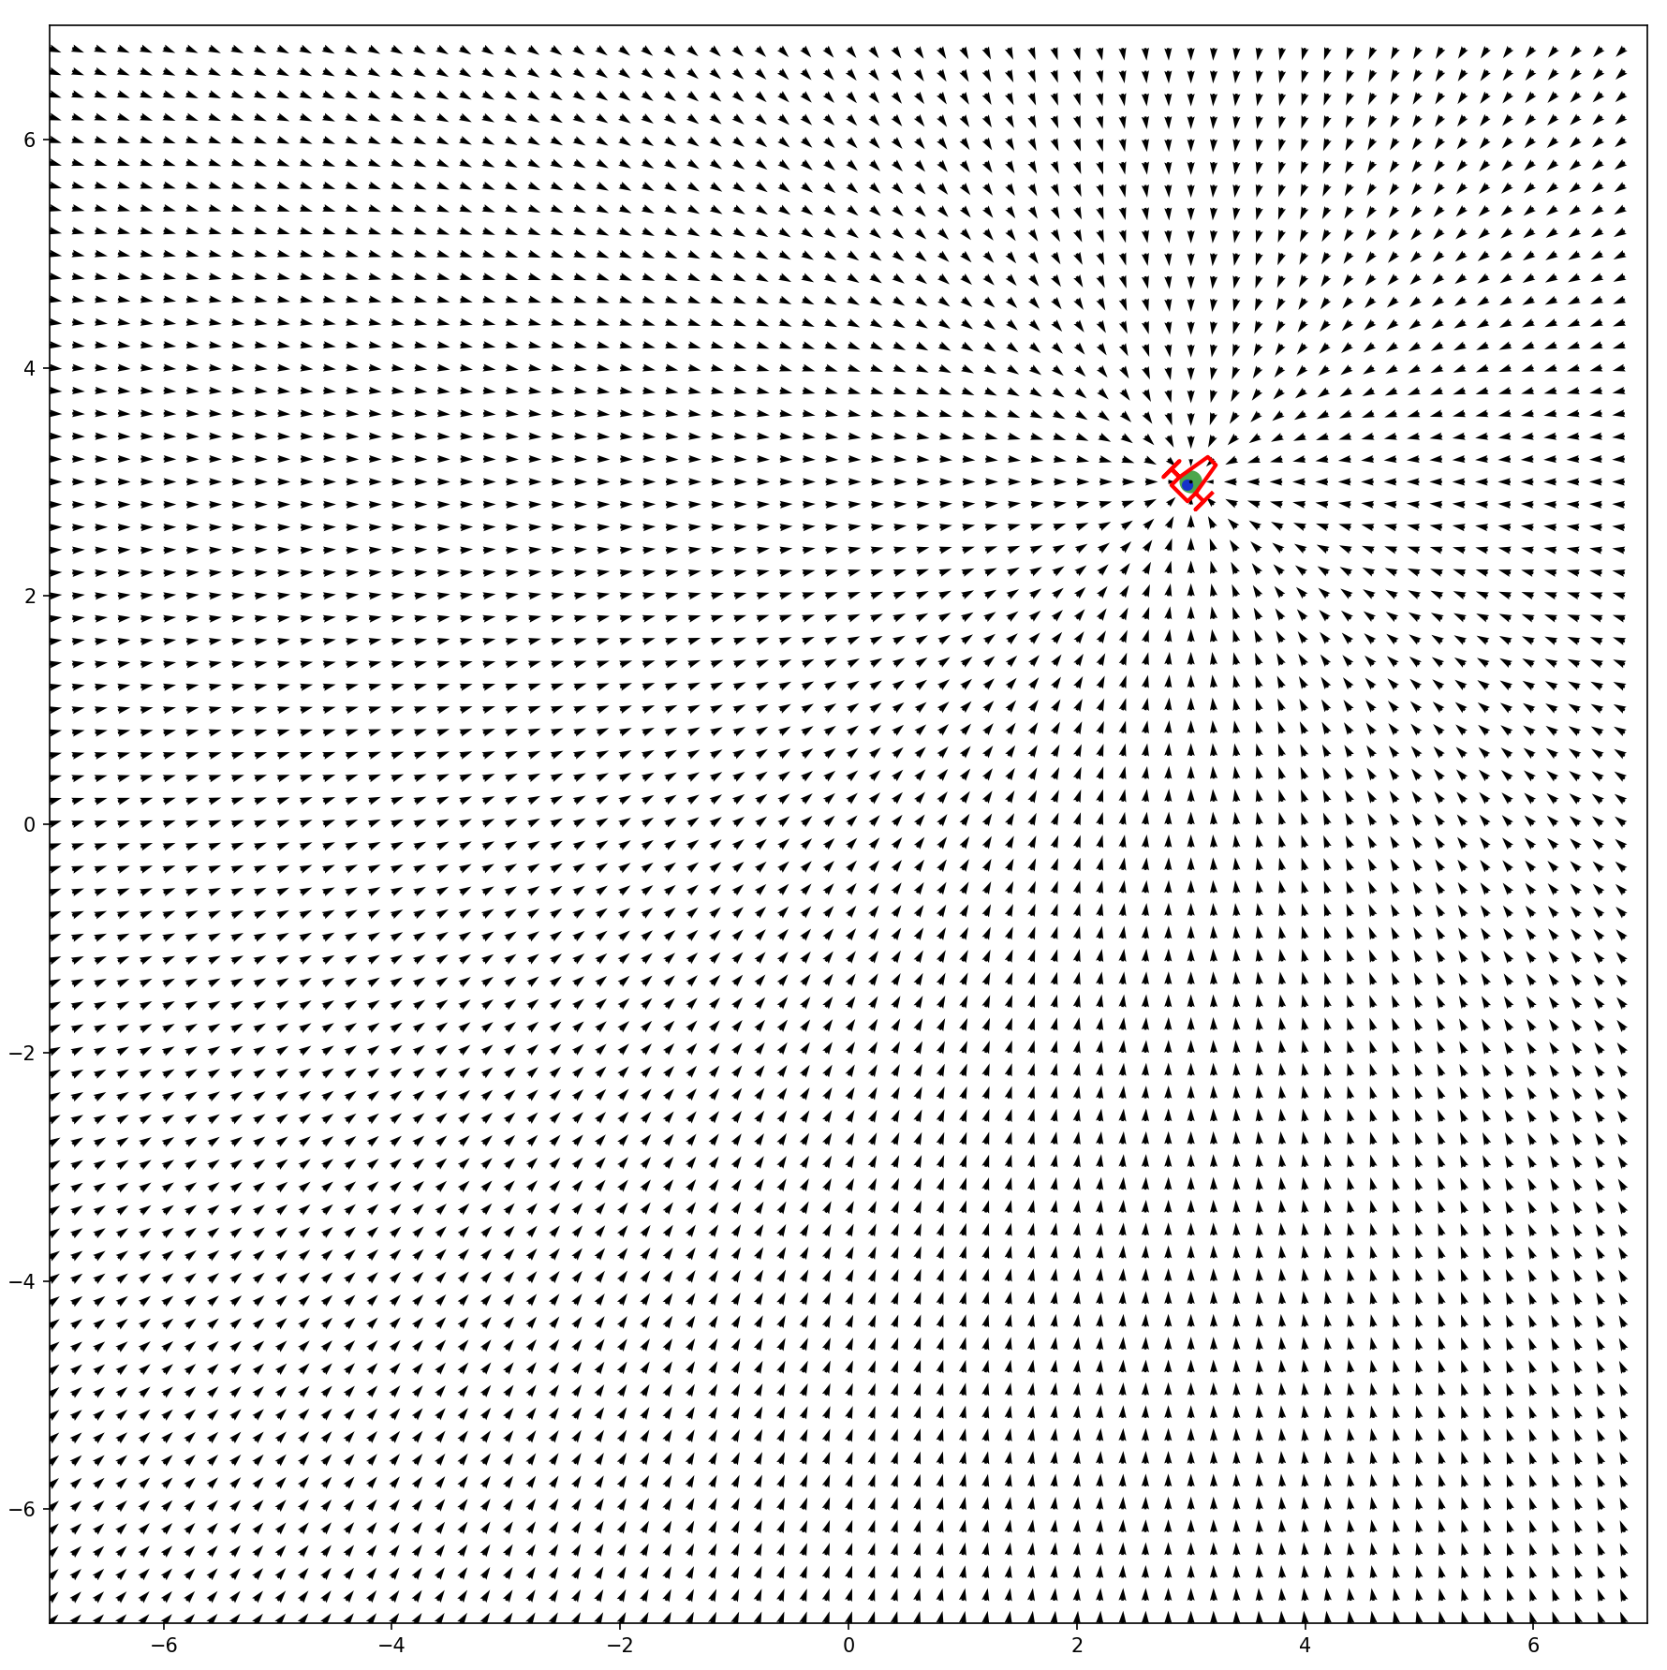
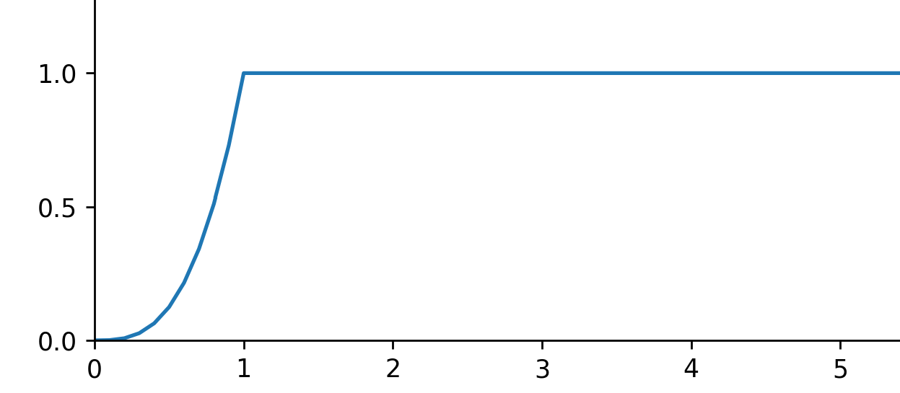
Visualization (Python program): Attractive only
Unclamped merged potentials
$$f\left(x\right)=x^{3}$$
Clamped merged potential
$$x=\left\|p−p_{r}\right\|$$
Ka: 3.0
Kr_dist: 0.0
Kr_height: 0.0
Kr_slope: 1.0
Min_spd_norm: 0.1
Max_spd_norm: 1.0

Slide 6
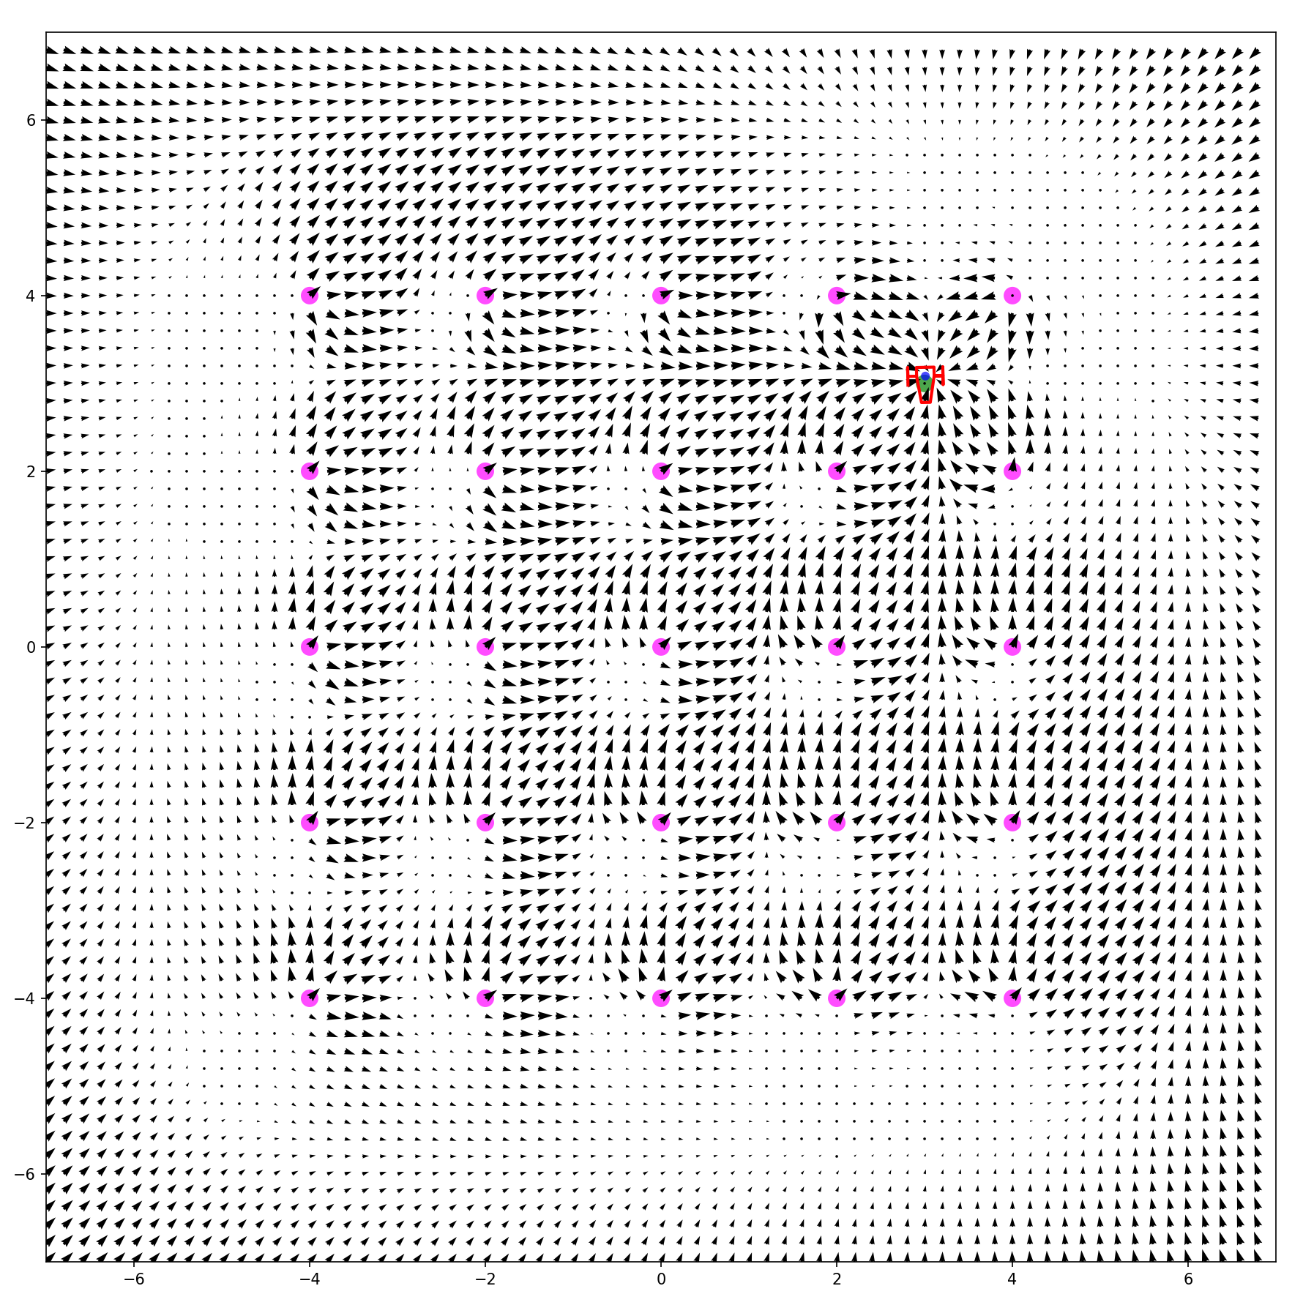
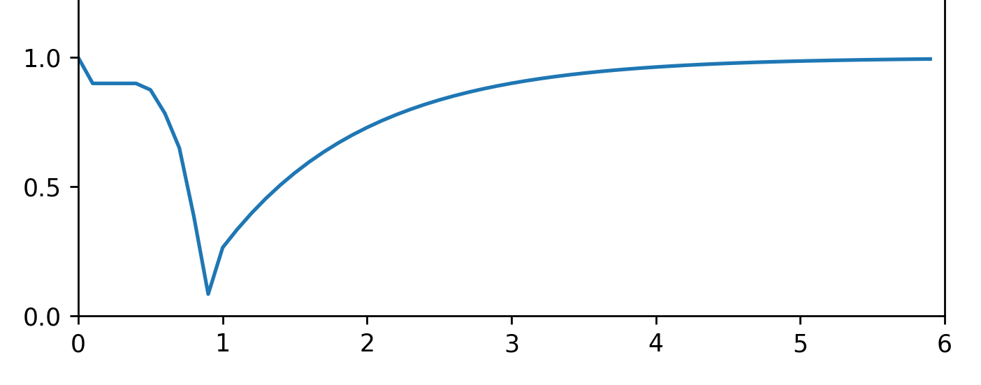
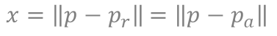
Visualization (Python program): Attractive + repulsive
Example of potential for coincident attractive and repulsive point
Visuals of how would be the potential V around a point $p_{r}$ = $p_{a}$
$$f\left(x\right)=abs(clamped(2 ∙exp⁡(1∙(0−x)))−clamped(x^{3}))$$
Robot follow –grad(V)
Repulsive area
Attractive area
Ka: 3.0
Kr_dist: 0.0
Kr_height: 2.0
Kr_slope: 1.0
Min_spd_norm: 0.1
Max_spd_norm: 1.0
$x=\left\|p−p_{r}\right\|$ $=\left\|p−p_{a}\right\|$
In this example the robot would converge to a position almost 1m away from the obstacle $p_{r}$

Slide 7
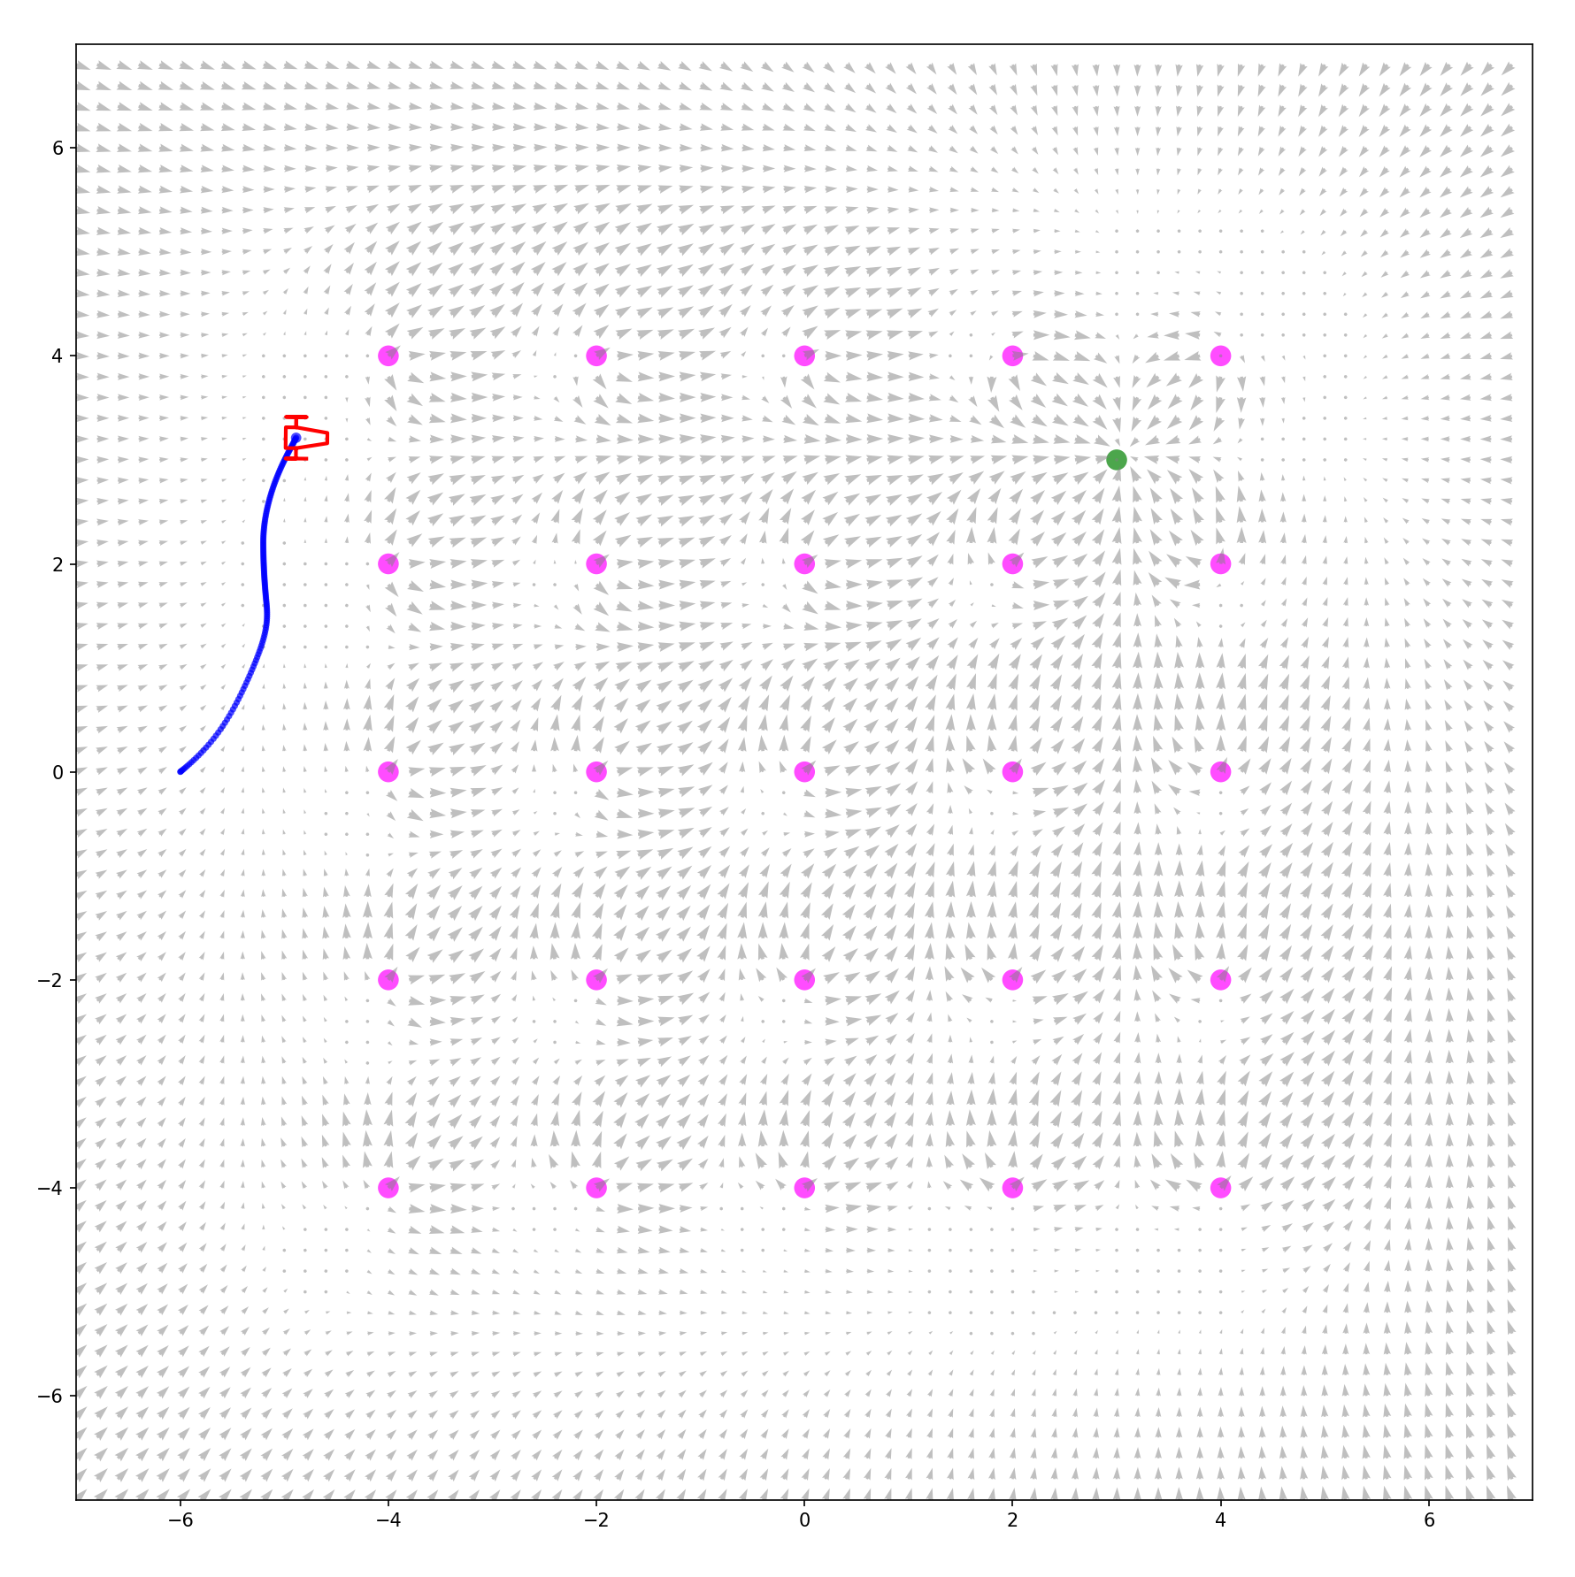
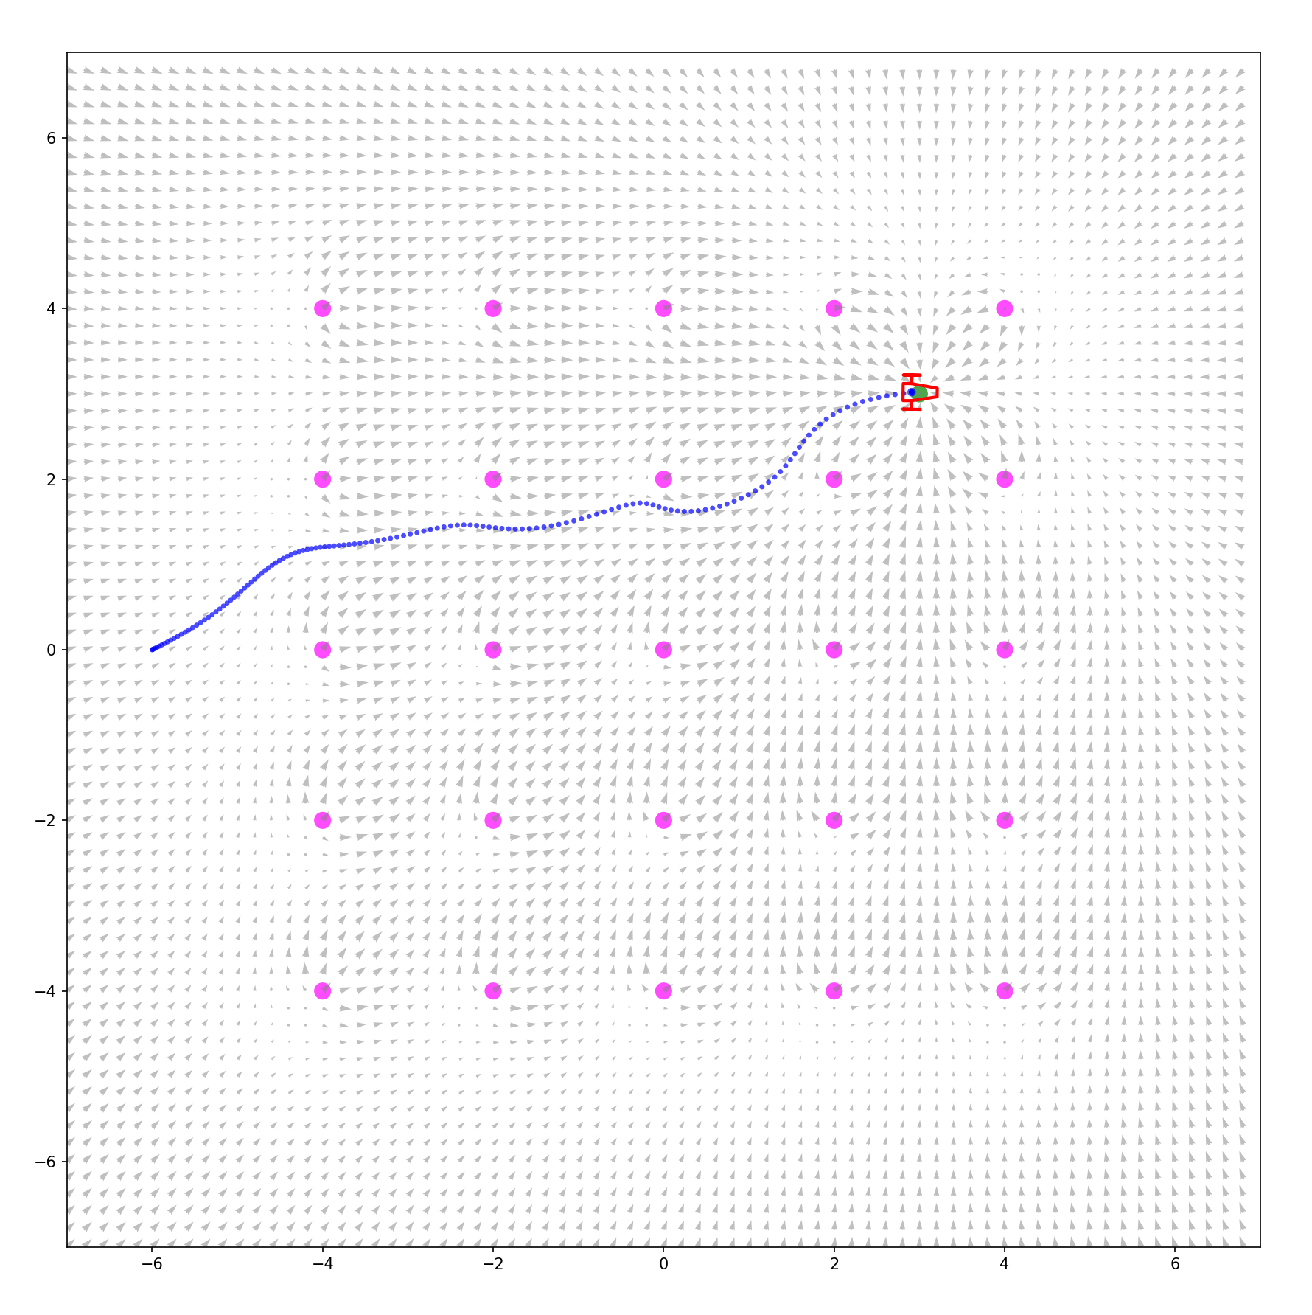
Simulation (Python program): Attractive + repulsive
We can customize the navigation behavior by changing the parameters
Can not go through
Can go through
Ka: 3.0
Kr_dist: 0.0
Kr_height: 2.0
Kr_slope: 1.0
Min_spd_norm: 0.1
Max_spd_norm: 1.0
Ka: 3.0
Kr_dist: -1.0
Kr_height: 3.0
Kr_slope: 1.0
Min_spd_norm: 0.1
Max_spd_norm: 1.0

Slide 8
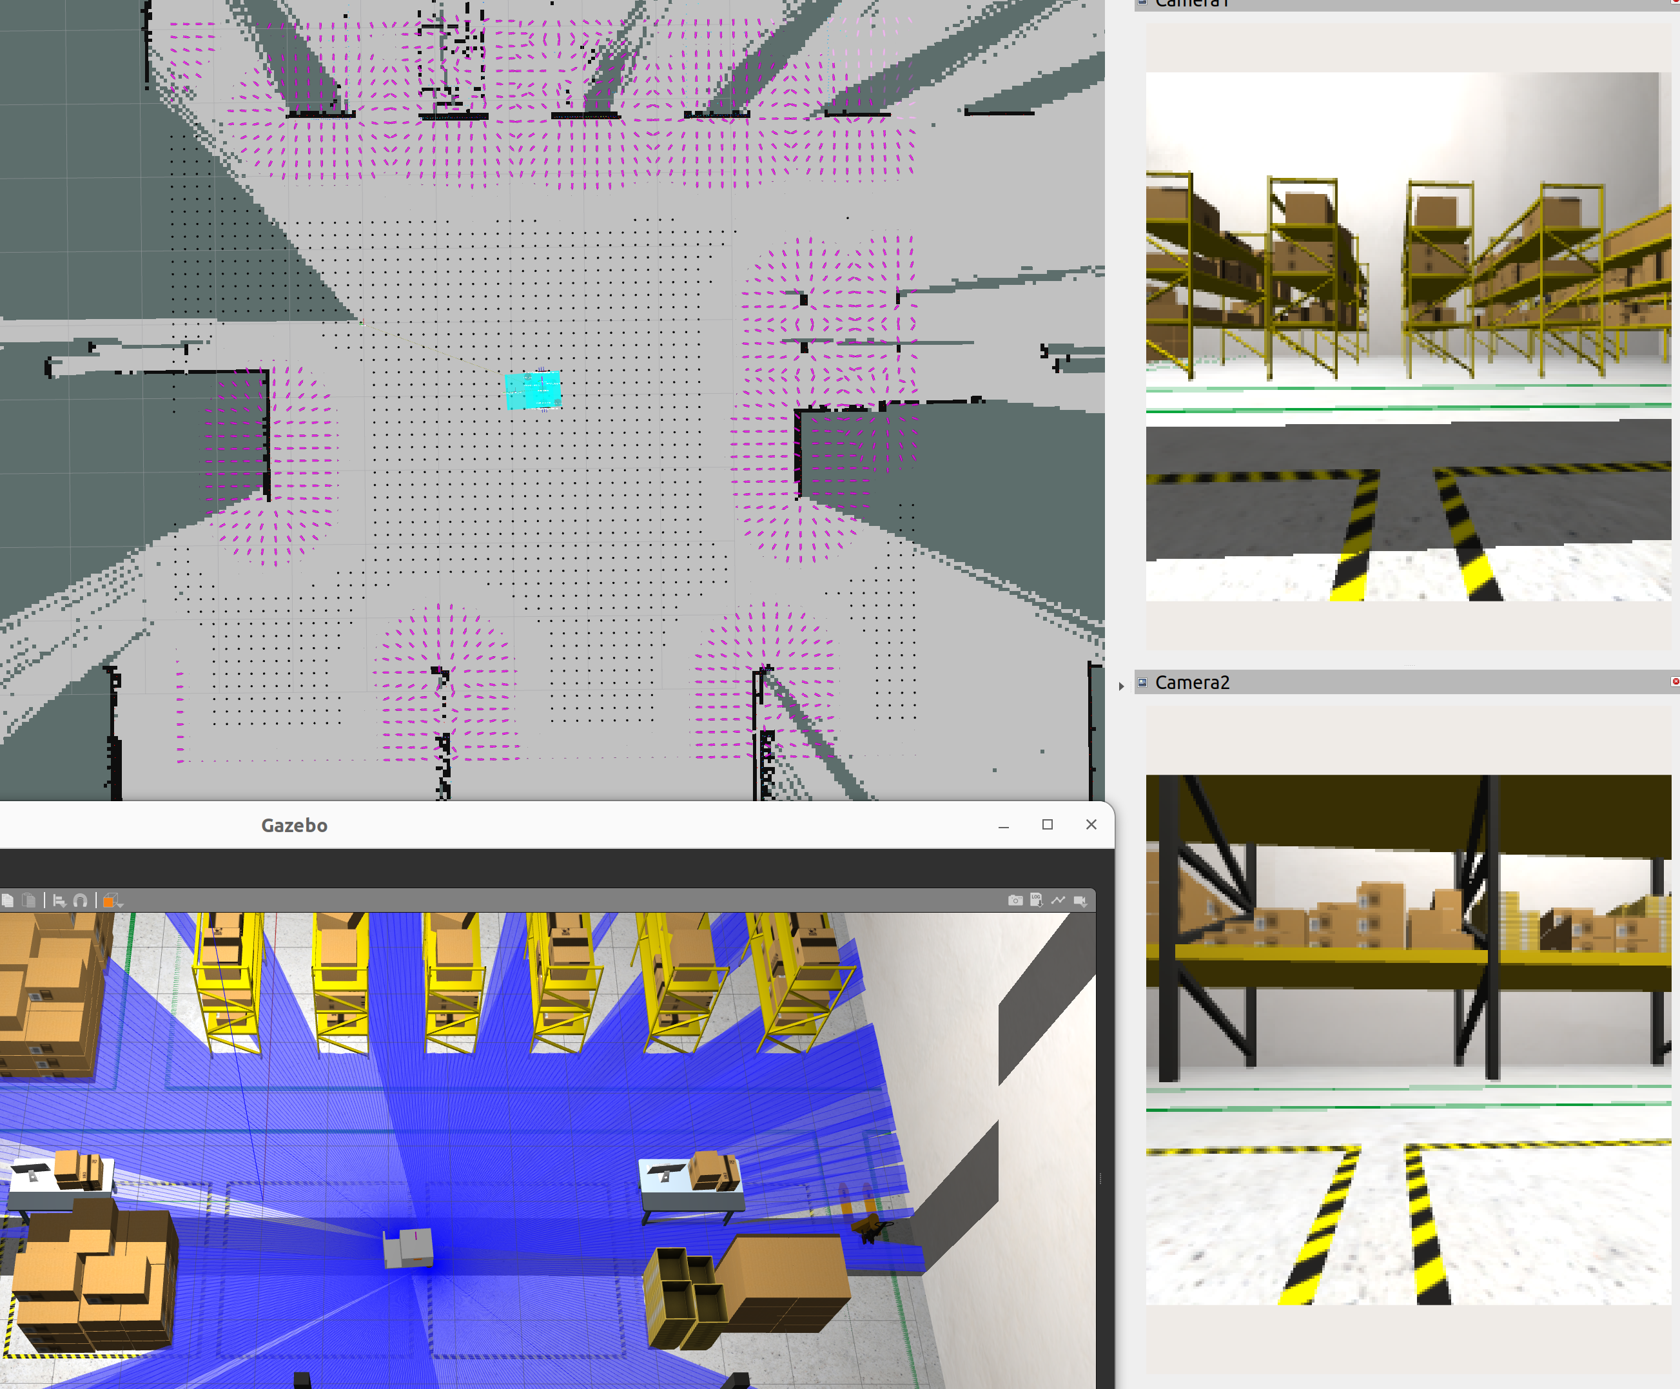
Visualization with ROS2 and Gazebo (simulated robot): Repulsive only
Ka: 0.0
Kr_dist: 0.8
Kr_height: 1.0
Kr_slope: 30.0
Min_spd_norm: 0.1
Max_spd_norm: 1.0

Slide 9
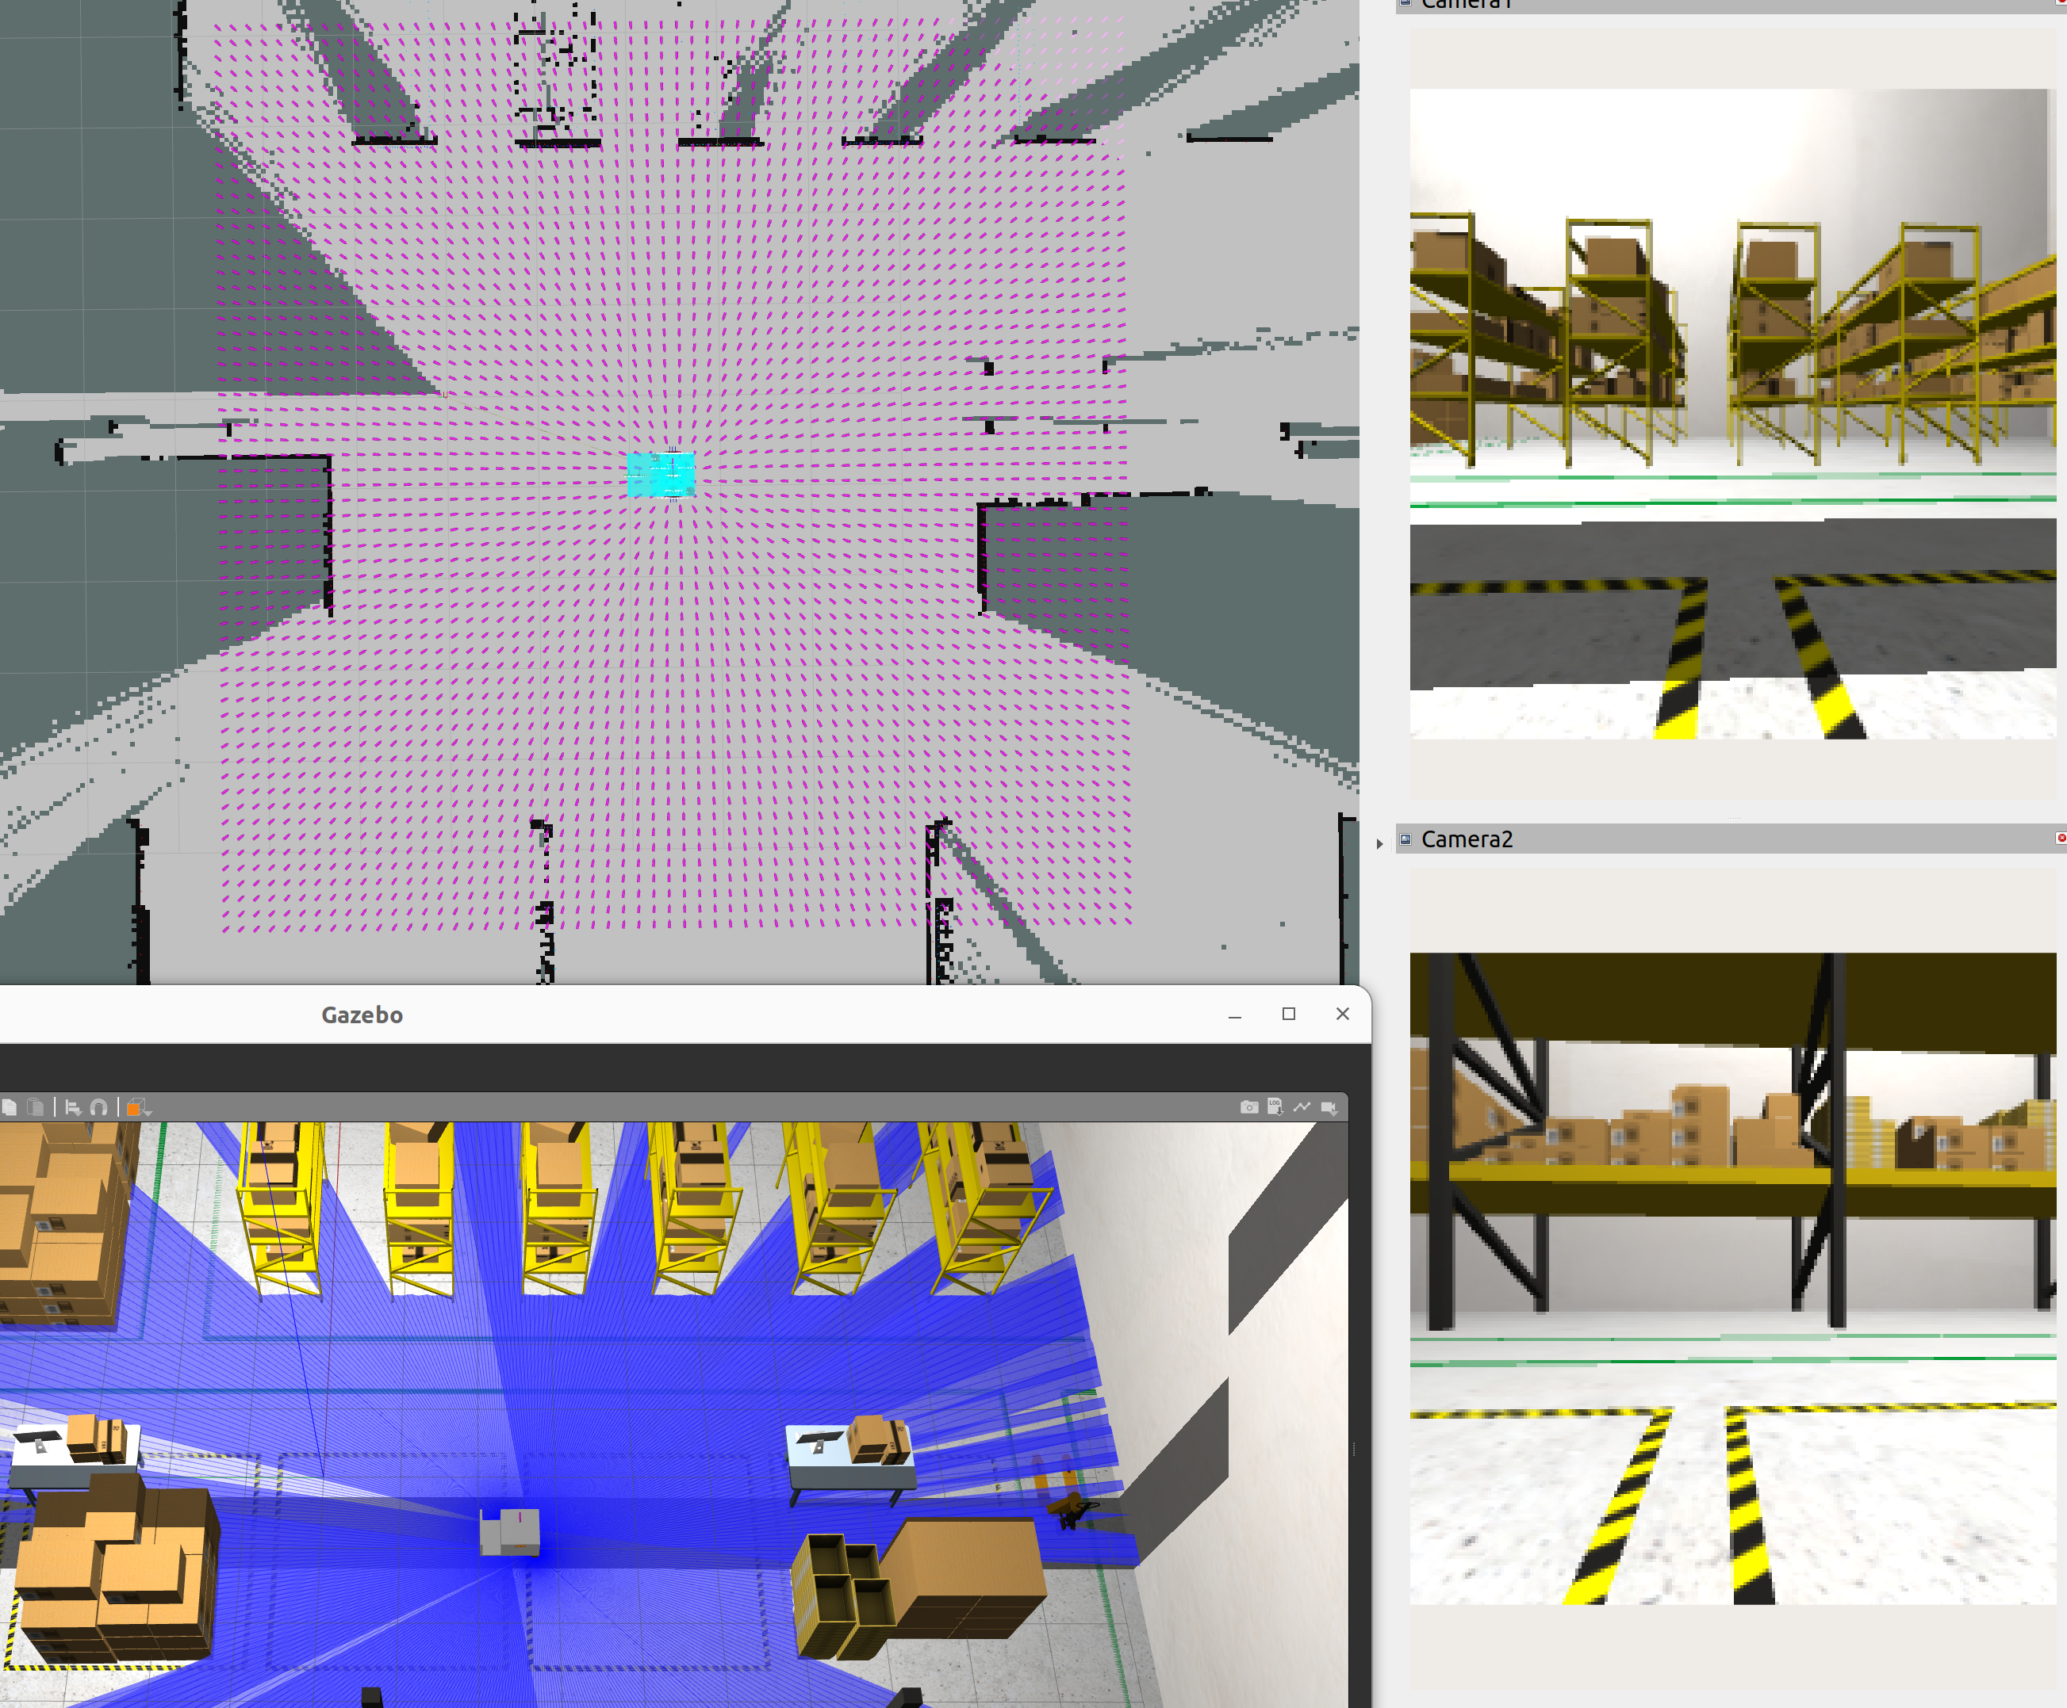
Visualization with ROS2 and Gazebo (simulated robot): Attractive only
Ka: 3.0
Kr_dist: 0.8
Kr_height: 0.0
Kr_slope: 30.0
Min_spd_norm: 0.1
Max_spd_norm: 1.0

Slide 10
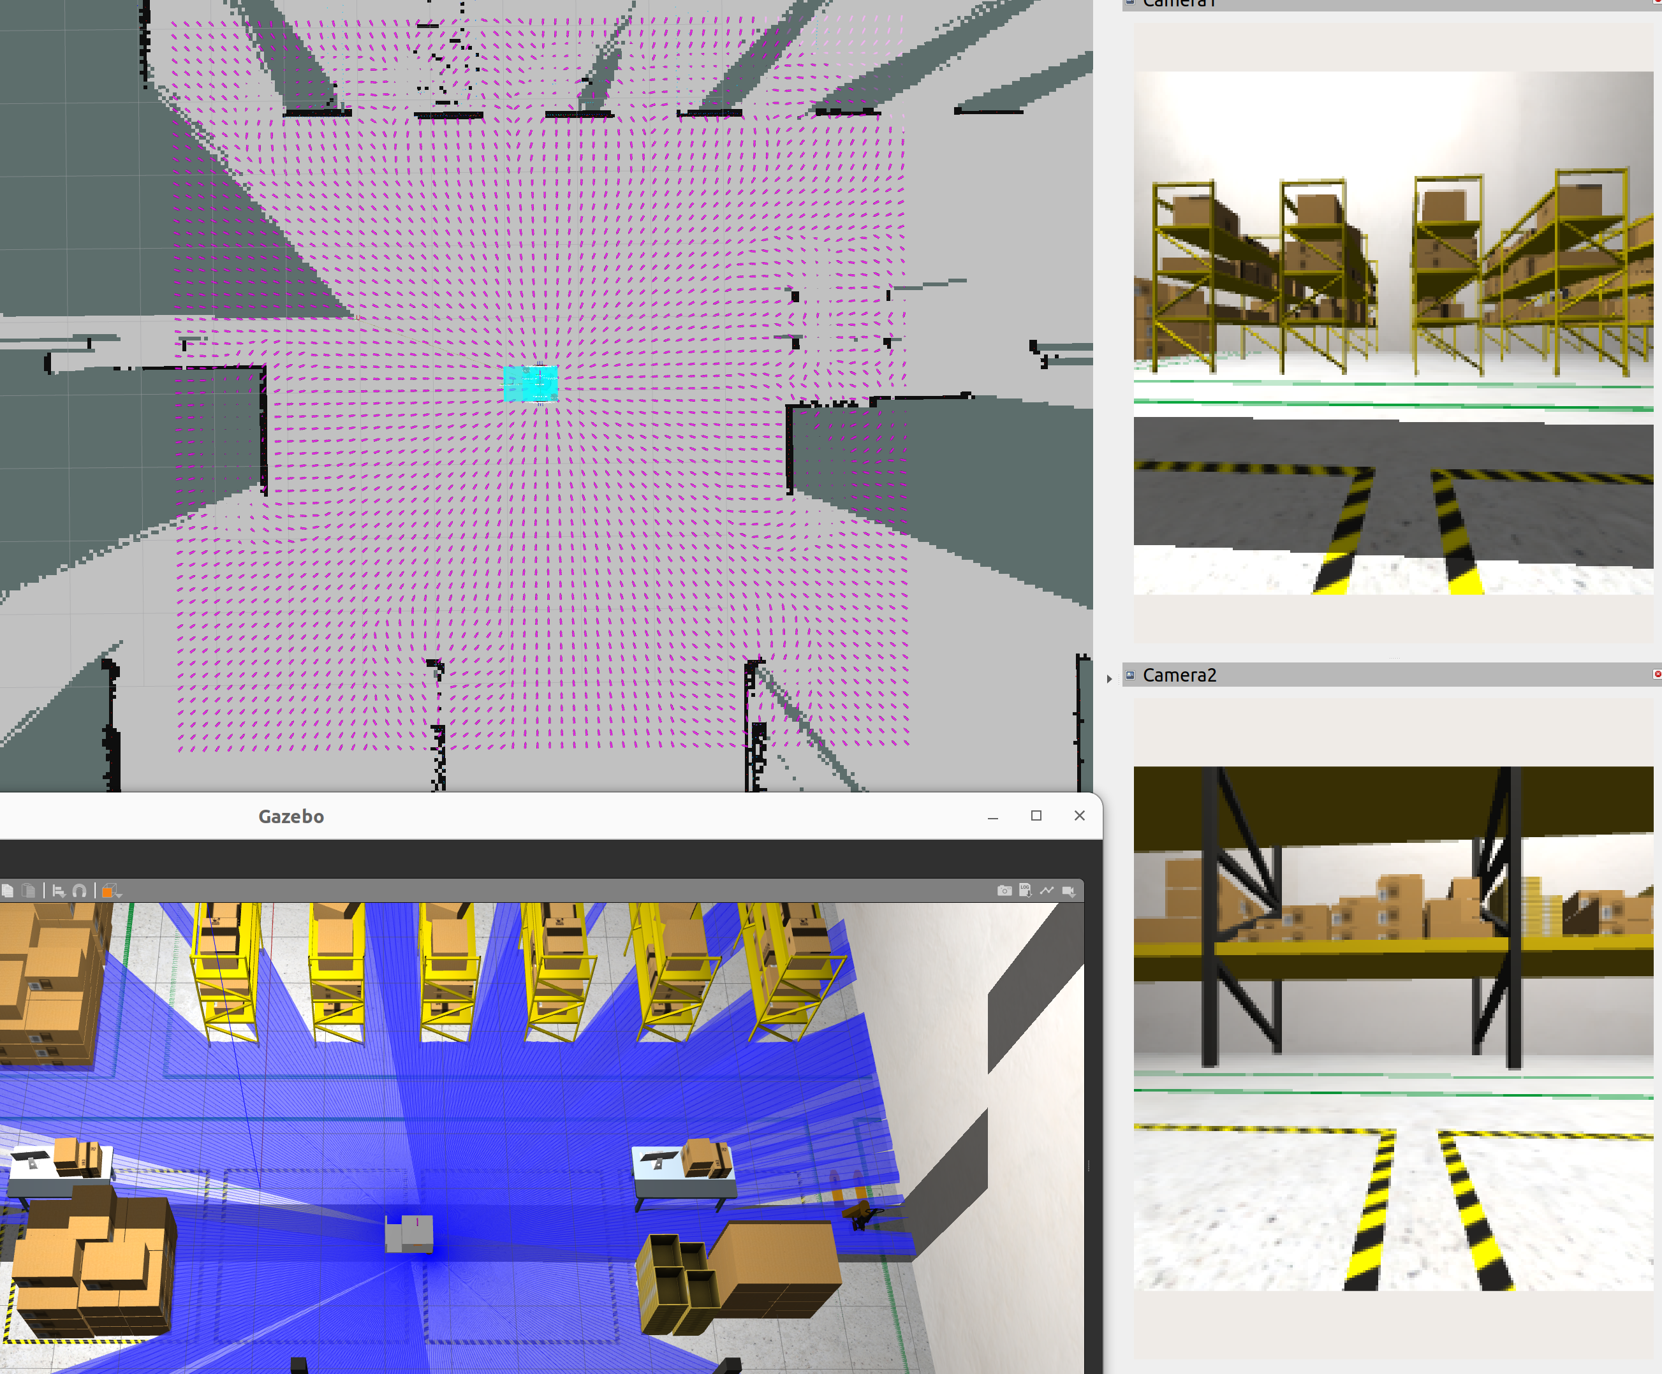
Visualization with ROS2 and Gazebo (simulated robot): Attractive + Repulsive
Ka: 3.0
Kr_dist: 0.8
Kr_height: 1.0
Kr_slope: 30.0
Min_spd_norm: 0.1
Max_spd_norm: 1.0

Slide 11
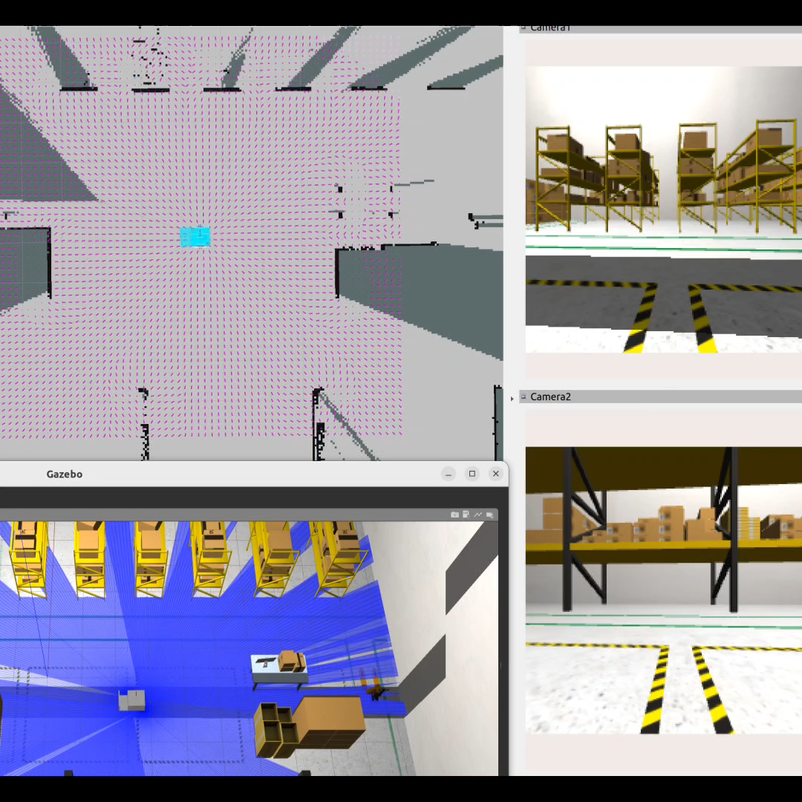
Simulation with ROS2 and Gazebo (simulated robot): Attractive + Repulsive
Ka: 3.0
Kr_dist: 0.8
Kr_height: 1.0
Kr_slope: 30.0
Min_spd_norm: 0.1
Max_spd_norm: 1.0
Attractive point
(Open doc.pptx to play the video)

